Slide 1
Deadlock
By: Er. Suvash Chandra Gautam(PhD Scholar)
February 15, 2024

Slide 2
Contents
a. Introduction
b. Conditions of deadlock
c. Resources and deadlock modeling using resources
d. Deadlock detection and recovery
e. Deadlock avoidance & prevention
f. Banker's Algorithm (Single and multiple resources)

Slide 3
Introduction
A Deadlock is a situation where each of the computer process waits for a resource which is being assigned to some another process. In this situation, none of the process gets executed since the resource it needs, is held by some other process which is also waiting for some other resource to be released.
Let us assume that there are three processes P1, P2 and P3. There are three different resources R1, R2 and R3. R1 is assigned to P1, R2 is assigned to P2 and R3 is assigned to P3.
After some time, P1 demands for R1 which is being used by P2. P1 halts its execution since it can't complete without R2. P2 also demands for R3 which is being used by P3. P2 also stops its execution because it can't continue without R3. P3 also demands for R1 which is being used by P1 therefore P3 also stops its execution.

Slide 4
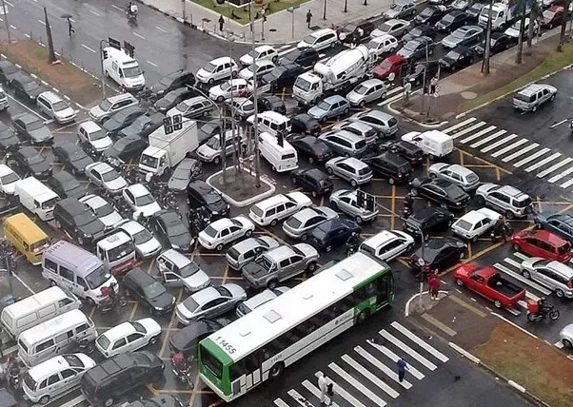

Slide 5
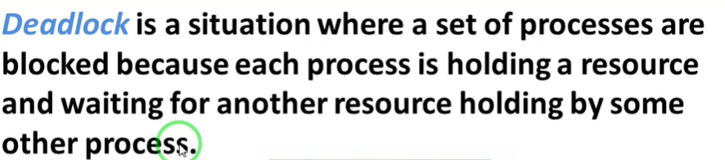

Slide 6
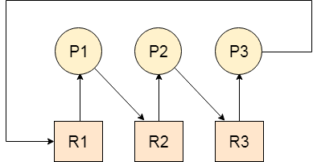
R1 is assigned to P1
R2 is assigned to P2
R3 is assigned to P3
P1 DEMANDS R2,
P2 DEMAND R3
AND P3 DEMAND R1 WHICH IS BEING USED BY P1
In this scenario, a cycle is being formed among the three processes. None of the process is progressing and they are all waiting. The computer becomes unresponsive since all the processes got blocked.

Slide 7
Deadlock is a situation where two or more processes are waiting for each other. For example, let us assume, we have two processes P1 and P2.
Now, process P1 is holding the resource R1 and is waiting for the resource R2.
At the same time, the process P2 is having the resource R2 and is waiting for the resource R1.
So, the process P1 is waiting for process P2 to release its resource and at the same time, the process P2 is waiting for process P1 to release its resource. And no one is releasing any resource. So, both are waiting for each other to release the resource.
This leads to infinite waiting and no work is done here. This is called Deadlock.

Slide 8
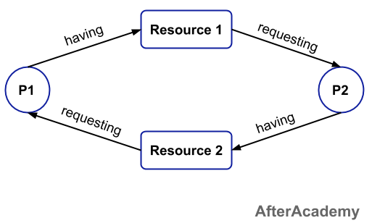

Slide 9
In operating systems, a deadlock occurs when two or more processes are unable to proceed because each is waiting for the other to release a resource. This situation typically arises in a system where resources are allocated to processes in a way that allows them to be used exclusively.
A process in operating system uses resources in the following way.
Requests a resource
Use the resource
Releases the resource
A deadlock is a situation where a set of processes are blocked because each process is holding a resource and waiting for another resource acquired by some other process.

Slide 10
Deadlock | Starvation
A deadlock is a situation where a set of processes are blocked because each process is holding a resource and waiting for another resource acquired by some other process. | Starvation is a situation where the low priority process got blocked and the high priority processes proceed.
Deadlock is an infinite waiting. | Starvation is a long waiting but not infinite.
Every Deadlock is always a starvation. | Every starvation need not be deadlock.
The requested resource is blocked by the other process. | The requested resource is continuously be used by the higher priority processes.
Deadlock happens when Mutual exclusion, hold and wait, No preemption and circular wait occurs simultaneously. | It occurs due to the uncontrolled priority and resource management.

Slide 11
Necessary Conditions for Deadlock
There are four different conditions that result in Deadlock. These four conditions are also known as Coffman conditions and these conditions are not mutually exclusive. Let's look at them one by one.
Mutual Exclusion.
Hold and Wait
No Preemption
Circular Wait

Slide 12
Mutual Exclusion
Mutual Exclusion: A resource can be held by only one process at a time.
In other words, if a process P1 is using some resource R at a particular instant of time, then some other process P2 can't hold or use the same resource R at that particular instant of time.
The process P2 can make a request for that resource R but it can't use that resource simultaneously with process P1.

Slide 13
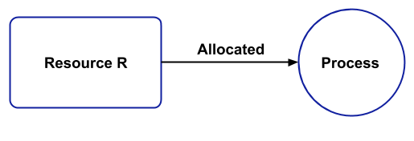

Slide 14
Hold and Wait
A process can hold a number of resources at a time and at the same time, it can request for other resources that are being held by some other process.
For example, a process P1 can hold two resources R1 and R2 and at the same time, it can request some resource R3 that is currently held by process P2.

Slide 15
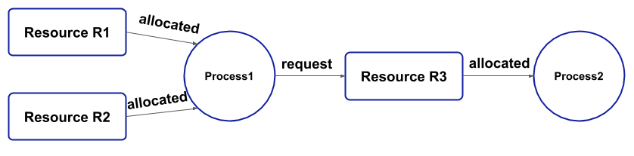

Slide 16
No preemption:
A resource can't be preempted from the process by another process, forcefully. For example, if a process P1 is using some resource R, then some other process P2 can't forcefully take that resource.
If it is so, then what's the need for various scheduling algorithm. The process P2 can request for the resource R and can wait for that resource to be freed by the process P1.

Slide 17
Circular Wait:
Circular wait is a condition when the first process is waiting for the resource held by the second process, the second process is waiting for the resource held by the third process, and so on.
At last, the last process is waiting for the resource held by the first process. So, every process is waiting for each other to release the resource and no one is releasing their own resource.
Everyone is waiting here for getting the resource. This is called a circular wait.

Slide 19
Summary
Mutual Exclusion: At least one resource must be held in a non-sharable mode. This means only one process can use the resource at a time. EX. ONE PROCESS CAN USE PRINTER AT A TIME. NO INTERLEAVING SCHEME.
Hold and Wait: A process must be holding at least one resource and waiting to acquire additional resources that are currently held by other processes.
No Preemption: Resources cannot be forcibly taken away from a process; they must be released voluntarily by the process holding them.
Circular Wait: A set of waiting processes must exist such that each process is waiting for a resource held by the next process in the set, creating a circular chain of dependencies.

Slide 20
Various Methods to handle Deadlock[IPAD]
Deadlock Ignorance(Ostrich Method)
Deadlock Prevention
Deadlock Avoidance (Banker’s Algorithm)
Deadlock Detection and Recovery

Slide 21
DEADLOCK IGNORANCE
It is also known as the OSTRICH METHOD.
There is no particular strategy to handle the deadlock.
No mechanism to handle the deadlock.
We ignore the problem all together and pretend that deadlock never occur in the system.
Most of the desktop computer uses the deadlock ignorance including UNIX.
Solution: Simply Restart the system.

Slide 22
DEADLOCK IGNORANCE
Deadlock Ignorance is the most widely used approach among all the mechanism. This is being used by many operating systems mainly for end user uses.
In this approach, the Operating system assumes that deadlock never occurs. It simply ignores deadlock. This approach is best suitable for a single end user system where User uses the system only for browsing and all other normal stuff.
There is always a tradeoff between Correctness and performance. The operating systems like Windows and Linux mainly focus upon performance

Slide 23
However, the performance of the system decreases if it uses deadlock handling mechanism all the time if deadlock happens 1 out of 100 times then it is completely unnecessary to use the deadlock handling mechanism all the time.
In these types of systems, the user has to simply restart the computer in the case of deadlock.
Windows and Linux are mainly using this approach.

Slide 24
Deadlock Prevention
If we simulate deadlock with a table which is standing on its four legs then we can also simulate four legs with the four conditions which when occurs simultaneously, cause the deadlock.
However, if we break one of the legs of the table then the table will fall definitely. The same happens with deadlock, if we can be able to violate one of the four necessary conditions and don't let them occur together then we can prevent the deadlock.
Deadlock prevention techniques refer to violating any one of the four necessary conditions. We will see one by one how we can violate each of them to make safe requests and which is the best approach to prevent deadlock.

Slide 25
A process is a set of instructions. When a process runs, it needs resources like CPU cycles, Files, or Peripheral device access.
Some of the requests for resources can lead to deadlock.
Deadlock prevention is eliminating one of the necessary conditions of deadlock so that only safe requests are made to OS and the possibility of deadlock is excluded before making requests.
As now requests are made carefully, the operating system can grant all requests safely.
Here OS does not need to do any additional tasks as it does in deadlock avoidance by running an algorithm on requests checking for the possibility of deadlock.

Slide 26
1. Mutual Exclusion
Some resources are inherently un shareable, for example, Printers. For un shareable resources, processes require exclusive control of the resources.
A mutual exclusion means that un shareable resources cannot be accessed simultaneously by processes.
Shared resources do not cause deadlock but some resources can't be shared among processes, leading to a deadlock.
For Example: read operation on a file can be done simultaneously by multiple processes, but write operation cannot. Write operation requires sequential access, so, some processes have to wait while another process is doing a write operation.

Slide 27
It is not possible to eliminate mutual exclusion, as some resources are inherently non-shareable,
For Example Tape drive, as only one process can access data from a Tape drive at a time.
For other resources like printers, we can use a technique called Spooling.
Spooling: It stands for Simultaneous Peripheral Operations online.
A Printer has associated memory which can be used as a spooler directory (memory that is used to store files that are to be printed next).

Slide 28
Hold and Wait
Hold and wait is a condition in which a process is holding one resource while simultaneously waiting for another resource that is being held by another process. The process cannot continue till it gets all the required resources.
Resource 1 is allocated to Process 2
Resource 2 is allocated to Process 1
Resource 3 is allocated to Process 1
Process 1 is waiting for Resource 1 and holding Resource 2 and Resource 3
Process 2 is waiting for Resource 2 and holding Resource 1

Slide 29
There are two ways to eliminate hold and wait:-
By eliminating wait:
The process specifies the resources it requires in advance so that it does not have to wait for allocation after execution starts.
For Example: Process1 declares in advance that it requires both Resource1 and Resource2
By eliminating hold:
The process has to release all resources it is currently holding before making a new request.
For Example: Process1 has to release Resource2 and Resource3 before making request for Resource1

Slide 30
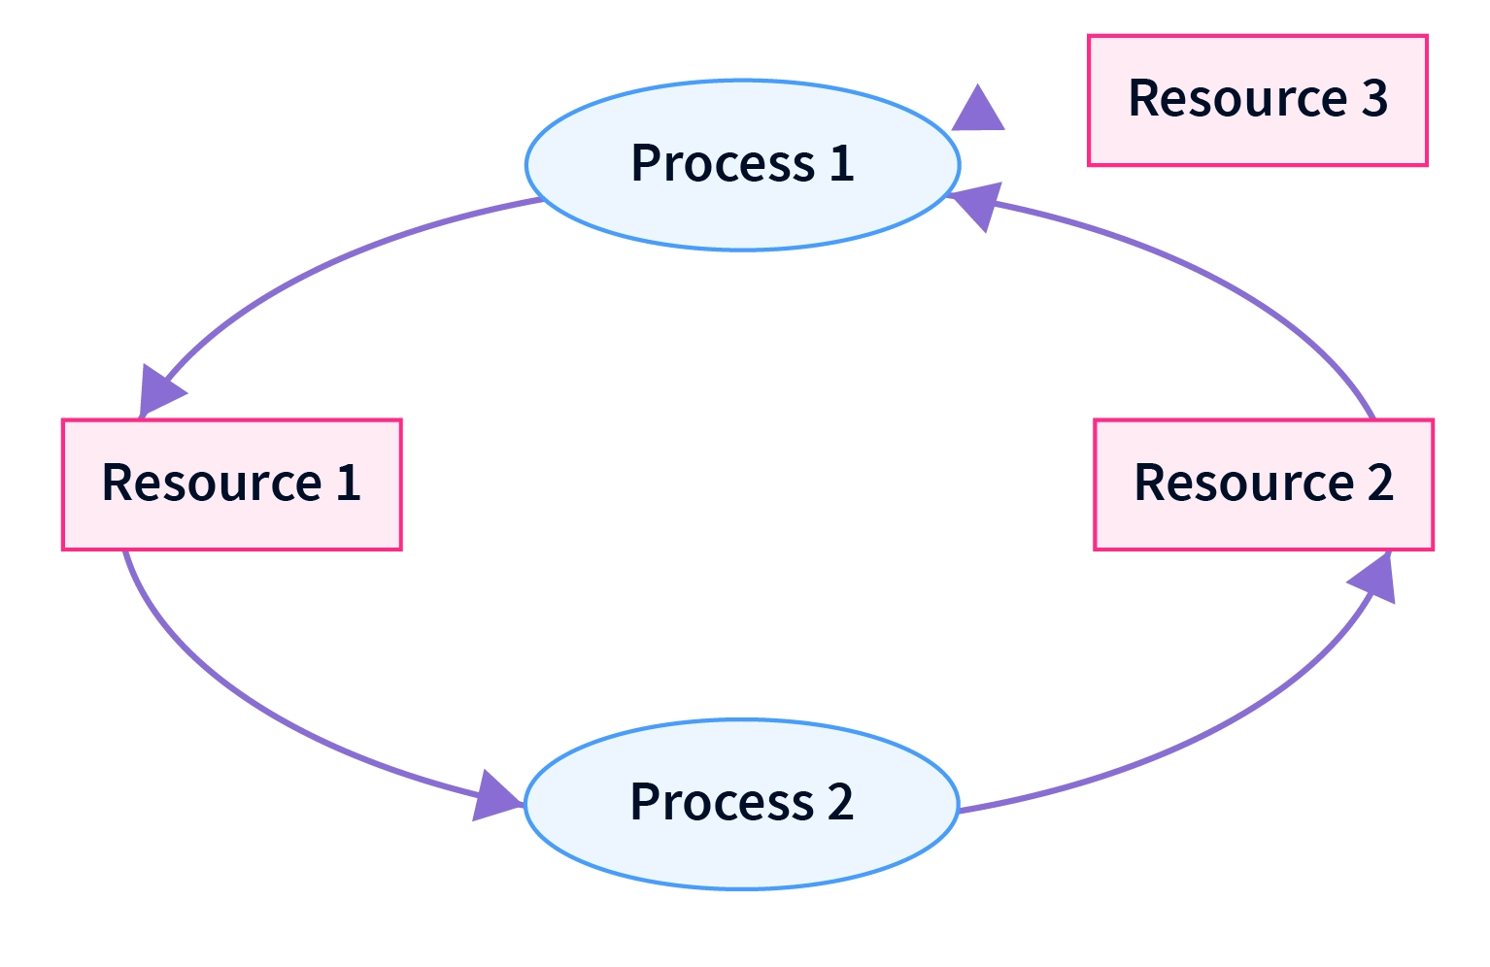

Slide 31
No preemption
Preemption is temporarily interrupting an executing task and later resuming it.
For example, if process P1 is using a resource and a high-priority process P2 requests for the resource, process P1 is stopped and the resources are allocated to P2.
There are two ways to eliminate this condition by preemption:
1. If a process is holding some resources and waiting for other resources, then it should release all previously held resources and put a new request for the required resources again. The process can resume once it has all the required resources.

Slide 32
For example: If a process has resources R1, R2, and R3 and it is waiting for resource R4, then it has to release R1, R2, and R3 and put a new request of all resources again.
2. If a process P1 is waiting for some resource, and there is another process P2 that is holding that resource and is blocked waiting for some other resource. Then the resource is taken from P2 and allocated to P1. This way process P2 is preempted and it requests again for its required resources to resume the task.
The above approaches are possible for resources whose states are easily restored and saved, such as memory and registers.

Slide 33
Challenges:
These approaches are problematic as the process might be actively using these resources and halting the process by preempting can cause inconsistency.
For example: If a process is writing to a file and its access is revoked for the process before it completely updates the file, the file will remain unusable and in an inconsistent state.
Putting requests for all resources again is inefficient and time-consuming.

Slide 34
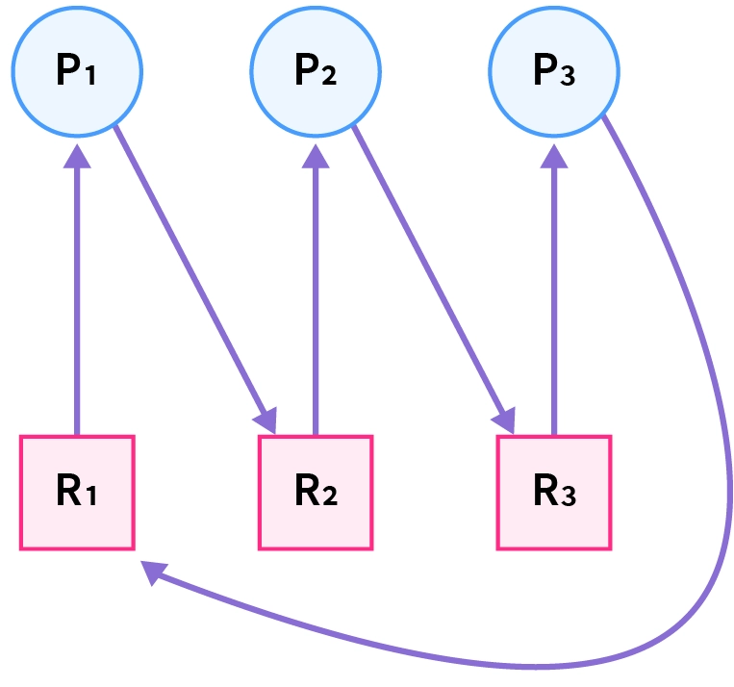
Circular Wait
In circular wait, two or more processes wait for resources in a circular order. We can understand this better by the diagram given below:

Slide 35
To eliminate circular wait, we assign a priority to each resource. A process can only request resources in increasing order of priority.
In the example above, process P3 is requesting resource R1, which has a number lower than resource R3 which is already allocated to process P3. So this request is invalid and cannot be made, as R1 is already allocated to process P1.
Challenges:
It is difficult to assign a relative priority to resources, as one resource can be prioritized differently by different processes.
For Example: A media player will give a lesser priority to a printer while a document processor might give it a higher priority. The priority of resources is different according to the situation and use case.

Slide 36
Feasibility of Deadlock Prevention
Mutual exclusion cannot be eliminated completely because some resources are inherently non-shareable
Hold and wait cannot be eliminated as we cannot know in advance about the required resources to prevent waiting. It is inefficient to prevent a hold by releasing all the resources while requesting a new one
Preempting processes can cause inconsistency and starting the process over by putting requests for all resources again is inefficient.
Eliminating circular wait is the only practical way to prevent deadlock.

Slide 37
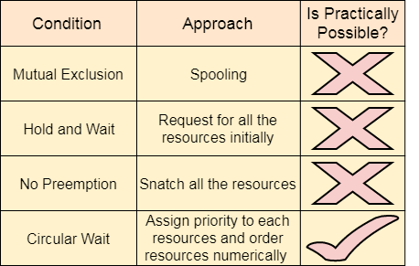

Slide 38
Deadlock Avoidance
A deadlock avoidance policy grants a resource request only if it can establish that granting the request cannot lead to a deadlock either immediately or in the future.
The kernal lacks detailed knowledge about future behavior of processes, so it cannot accurately predict deadlocks. To facilitate deadlock avoidance under these conditions, it uses the following conservative approach: Each process declares the maximum number of resource units of each class that it may require.
The kernal permits a process to request these resource units in stages- i.e. a few resource units at a time- subject to the maximum number declared by it and uses a worst case analysis technique to check for the possibility of future deadlocks.
A request is granted only if there is no possibility of deadlocks; otherwise, it remains pending until it can be granted. This approach is conservative because a process may complete its operation without requiring the maximum number of units declared by it.

Slide 39
Resource Allocation Graph
The resource allocation graph (RAG) is used to visualize the system’s current state as a graph. The Graph includes all processes, the resources that are assigned to them, as well as the resources that each Process requests.
Sometimes, if there are fewer processes, we can quickly spot a deadlock in the system by looking at the graph rather than the tables we use in Banker’s algorithm.
Deadlock avoidance can also be done with Banker’s Algorithm.

Slide 40
Banker’s Algorithm/Deadlock Avoidance/Deadlock Detection
Bankers’s Algorithm is a resource allocation and deadlock avoidance algorithm which test all the request made by processes for resources, it checks for the safe state, and after granting a request system remains in the safe state it allows the request, and if there is no safe state it doesn’t allow the request made by the process.
Inputs to Banker’s Algorithm
Max needs of resources by each process.
Currently, allocated resources by each process.
Max free available resources in the system.

Slide 41
The request will only be granted under the below condition
If the request made by the process is less than equal to the max needed for that process.
If the request made by the process is less than equal to the freely available resource in the system.
Timeouts: To avoid deadlocks caused by indefinite waiting, a timeout mechanism can be used to limit the amount of time a process can wait for a resource. If the help is unavailable within the timeout period, the process can be forced to release its current resources and try again later.
Need = Maximum Resources Requirement – Currently Allocated Resources.
AVAILABE=TOTAL-ALLOCATED

Slide 42
The Banker's algorithm is a deadlock avoidance algorithm used in operating systems to allocate resources to processes in a safe manner, ensuring that deadlock cannot occur. It was developed by Edsger W. Dijkstra in 1965. The algorithm is primarily used in systems where resources are allocated in advance and can be safely released when no longer needed.
Resources: These are the various types of resources available in the system, such as printers, memory blocks, etc.
Processes: These are the tasks or programs running in the system that require resources to execute.
Available: This is a vector indicating the number of available instances of each resource type.
Allocation: This is a matrix indicating the number of resources of each type currently allocated to each process.
Maximum: This is a matrix indicating the maximum number of resources of each type that each process may request.

Slide 43
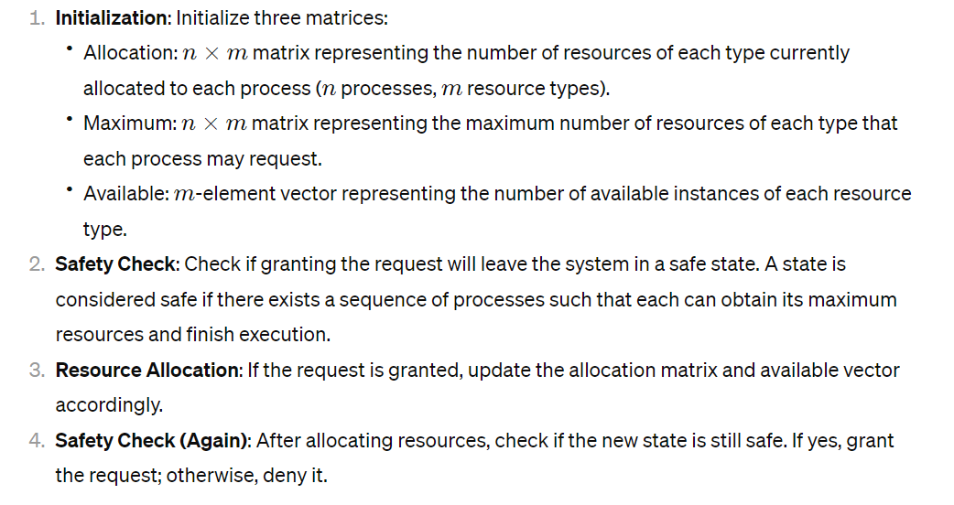

Slide 44
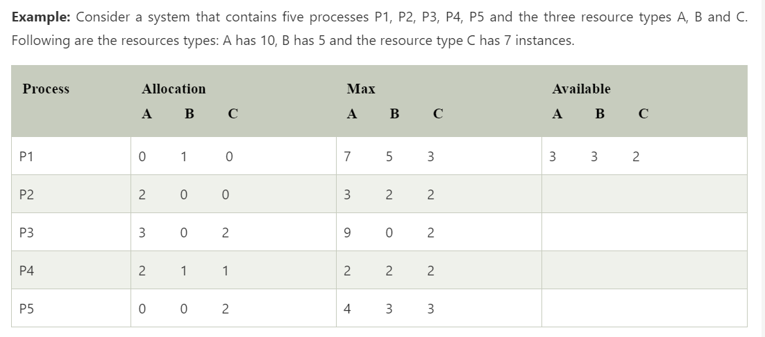

Slide 45
Banker’s Algorithm History
It is a banker algorithm used to avoid deadlock and allocate resources safely to each process in the computer system.
The 'S-State' examines all possible tests or activities before deciding whether the allocation should be allowed to each process.
It also helps the operating system to successfully share the resources between all the processes.
The banker's algorithm is named because it checks whether a person should be sanctioned a loan amount or not to help the bank system safely simulate allocation resources.
In this section, we will learn the Banker's Algorithm in detail. Also, we will solve problems based on the Banker's Algorithm. To understand the Banker's Algorithm first we will see a real word example of it.

Slide 46
Suppose the number of account holders in a particular bank is 'n', and the total money in a bank is 'T’.
If an account holder applies for a loan; first, the bank subtracts the loan amount from full cash and then estimates the cash difference is greater than T to approve the loan amount.
These steps are taken because if another person applies for a loan or withdraws some amount from the bank, it helps the bank manage and operate all things without any restriction in the functionality of the banking system.

Slide 47
Similarly, it works in an operating system. When a new process is created in a computer system, the process must provide all types of information to the operating system like upcoming processes, requests for their resources, counting them, and delays.
Based on these criteria, the operating system decides which process sequence should be executed or waited so that no deadlock occurs in a system.
Therefore, it is also known as deadlock avoidance algorithm or deadlock detection in the operating system.

Slide 48
Advantages
It contains various resources that meet the requirements of each process.
Each process should provide information to the operating system for upcoming resource requests, the number of resources, and how long the resources will be held.
It helps the operating system manage and control process requests for each type of resource in the computer system.
The algorithm has a Max resource attribute that represents indicates each process can hold the maximum number of resources in a system.

Slide 49
Consider a system that contains five process P1, P2, P3, P4, P5 and the three resources type A,B and C. Following are the resources types: A has 10, B has 5 and the resource type C has 7 Instance.
PROCESS | ALLOCATION |  |  | MAX NEED |  |  | AVAILABE |  |  | REMAINING NEED
 | A | B | C | A | B | C | A | B | C | A | B | C
P1 | 0 | 1 | 0 | 7 | 5 | 3
P2 | 2 | 0 | 2 | 3 | 2 | 2
P3 | 3 | 0 | 2 | 9 | 0 | 2
P4 | 2 | 1 | 1 | 4 | 2 | 2
P5 | 0 | 0 | 2 | 5 | 3 | 3

Slide 50
Deadlock Avoidance algorithm/Also used for Deadlock Detection(Deadlock Occur in future or not)
Five Process request the resources( A, B, C)
A=CPU, B=MEMORY, C=PRINTER LET SAY.
A=10 CPU/INSTANCES, B=5 MEMORY/INSTANCES, C=5 PRINTER/INSTANCE
ALLOCATION tells how many resources system has already given to a particular process.
Maximum need means which process needs how many resources?
If there is a deadlock then simply you can say that this is unsafe.
Safe Means deadlock will not occur.
And unsafe means deadlock will occur.

Slide 51
If deadlock does not occur then its sequence comes we call safe sequence. Safe sequence means how do we sequence resources and process so that deadlock does not occur.
Available means how much is the total availability of resources we have. Total we have 10, 5 and 7.

Slide 52
PROCESS | ALLOCATION |  |  | MAX NEED |  |  | AVAILABE |  |  | REMAINING NEED
 | A | B | C | A | B | C | A | B | C | A | B | C
P1 | 0 | 1 | 0 | 7 | 5 | 3 | 10-7=3 | 5-2=3 | 7-5=2
P2 | 2 | 0 | 0 | 3 | 2 | 2
P3 | 3 | 0 | 2 | 9 | 0 | 2
P4 | 2 | 1 | 1 | 4 | 2 | 2
P5 | 0 | 0 | 2 | 5 | 3 | 3
Total | 7 | 2 | 5
7 resources of A, 2 Resources of B and 5 Resources of C are already allocated.

Slide 53
Current Availability=(3,3,2)
Step 2: Remaining Need=Max. Need-Allocation
Remaining Need of P1= (7-0)=0, (3-2)=1,
PROCESS | ALLOCATION |  |  | MAX NEED |  |  | AVAILABE |  |  | REMAINING NEED
 | A | B | C | A | B | C | A | B | C | A | B | C
P1 | 0 | 1 | 0 | 7 | 5 | 3 | 10-7=3 | 5-2=3 | 7-5=2 | 7-0=7 | 5-1=4 | 3-0=3
P2 | 2 | 0 | 0 | 3 | 2 | 2 |  |  |  | 3-2=1 | 2-0=2 | 2-0=2
P3 | 3 | 0 | 2 | 9 | 0 | 2 |  |  |  | 9-3=6 | 0-0=0 | 2-2=0
P4 | 2 | 1 | 1 | 4 | 2 | 2 |  |  |  | 4-2=2 | 2-2=1 | 2-1=1
P5 | 0 | 0 | 2 | 5 | 3 | 3 |  |  |  | 5-0=5 | 3-0=3 | 3-2=1
Total | 7 | 2 | 5

Slide 54
PROCESS | ALLOCATION |  |  | MAX NEED |  |  | AVAILABE |  |  | REMAINING NEED
 | A | B | C | A | B | C | A | B | C | A | B | C
P1 | 0 | 1 | 0 | 7 | 5 | 3 | 3 | 3 | 2 | 7 | 4 | 3
P2 | 2 | 0 | 0 | 3 | 2 | 2 |  |  |  | 1 | 2 | 2
P3 | 3 | 0 | 2 | 9 | 0 | 2 |  |  |  | 6 | 0 | 0
P4 | 2 | 1 | 1 | 4 | 2 | 2 |  |  |  | 2 | 1 | 1
P5 | 0 | 0 | 2 | 5 | 3 | 3 |  |  |  | 5 | 3 | 1
Total | 7 | 2 | 5

Slide 55
For Process P1:
Need <= Available
7, 4, 3 <= 3, 3, 2 condition is false.[The remaining need to P1 can not be fulfilled, thus we cannot keep P1 in sequence]
For Process P2:
Need<= Available
1,2,2<=3,3,2 [ True, The remaining need of P2 can be fulfilled]
[All three resources are to be provided at once not individually]
P2 is successfully executed and terminated.
Now, New Available= allocation of P2+Current Available
=(2,0,0)+(3,3,2)=(2+3,0+3,0+2)=(5,3,2)

Slide 56
PROCESS | ALLOCATION |  |  | MAX NEED |  |  | AVAILABE |  |  | REMAINING NEED
 | A | B | C | A | B | C | A | B | C | A | B | C
P1 | 0 | 1 | 0 | 7 | 5 | 3 | 3 | 3 | 2 | 7 | 4 | 3
P2 | 2 | 0 | 0 | 3 | 2 | 2 | 5 | 3 | 2 | 1 | 2 | 2
P3 | 3 | 0 | 2 | 9 | 0 | 2 |  |  |  | 6 | 0 | 0
P4 | 2 | 1 | 1 | 4 | 2 | 2 |  |  |  | 2 | 1 | 1
P5 | 0 | 0 | 2 | 5 | 3 | 3 |  |  |  | 5 | 3 | 1
Total | 7 | 2 | 5

Slide 57
The remaining need of P2 is full filled thus it will be removed from the system.

Slide 58
PROCESS | ALLOCATION |  |  | MAX NEED |  |  | AVAILABE |  |  | REMAINING NEED
 | A | B | C | A | B | C | A | B | C | A | B | C
P1 | 0 | 1 | 0 | 7 | 5 | 3 | 3 | 3 | 2 | 7 | 4 | 3
P2 | 2 | 0 | 0 | 3 | 2 | 2 | 5 | 3 | 2
P3 | 3 | 0 | 2 | 9 | 0 | 2 |  |  |  | 6 | 0 | 0
P4 | 2 | 1 | 1 | 4 | 2 | 2 |  |  |  | 2 | 1 | 1
P5 | 0 | 0 | 2 | 5 | 3 | 3 |  |  |  | 5 | 3 | 1
Total | 7 | 2 | 5

Slide 59
Similarly, we examine another process P3.For Process P3,
Step 3: For Process P3:
P3 Need <= Available
6, 0, 0 < = 5, 3, 2 condition is false.
Similarly, we examine another process, P4.
Step 4: For Process P4:
P4 Need <= Available
2, 1, 1 <= 5, 3, 2 condition is true
New Available resource = Available + Allocation
5, 3, 2 + 2, 1, 1 => 7, 4, 3
Process P4 is successfully executed. P4 will be successfully terminated and removed from system.

Slide 60
PROCESS | ALLOCATION |  |  | MAX NEED |  |  | AVAILABE |  |  | REMAINING NEED
 | A | B | C | A | B | C | A | B | C | A | B | C
P1 | 0 | 1 | 0 | 7 | 5 | 3 | 3 | 3 | 2 | 7 | 4 | 3
P2 | 2 | 0 | 0 | 3 | 2 | 2 | 5 | 3 | 2
P3 | 3 | 0 | 2 | 9 | 0 | 2 | 7 | 4 | 3 | 6 | 0 | 0
P4 | 2 | 1 | 1 | 4 | 2 | 2
P5 | 0 | 0 | 2 | 5 | 3 | 3 |  |  |  | 5 | 3 | 1
Total | 7 | 2 | 5

Slide 61
Similarly, we examine another process P5.
Step 5: For Process P5:
P5 Need <= Available
5, 3, 1 <= 7, 4, 3 condition is true
New available resource = Available + Allocation
(7, 4, 3 + 0, 0, 2) => 7, 4, 5
Process P5 is successfully executed. P5 will be successfully terminated and removed from system.

Slide 62
PROCESS | ALLOCATION |  |  | MAX NEED |  |  | AVAILABE |  |  | REMAINING NEED
 | A | B | C | A | B | C | A | B | C | A | B | C
P1 | 0 | 1 | 0 | 7 | 5 | 3 | 3 | 3 | 2 | 7 | 4 | 3
P2 | 2 | 0 | 0 | 3 | 2 | 2 | 5 | 3 | 2
P3 | 3 | 0 | 2 | 9 | 0 | 2 | 7 | 4 | 3 | 6 | 0 | 0
P4 | 2 | 1 | 1 | 4 | 2 | 2 | 7 | 4 | 5
P5 | 0 | 0 | 2 | 5 | 3 | 3
Total | 7 | 2 | 5

Slide 63
Step 6: For Process P1:
P1 Need <= Available
7, 4, 3 <= 7, 4, 5 condition is true
New Available Resource = Available + Allocation
7, 4, 5 + 0, 1, 0 => 7, 5, 5
P1 is successfully executed and removed it from system.

Slide 64
PROCESS | ALLOCATION |  |  | MAX NEED |  |  | AVAILABE |  |  | REMAINING NEED
 | A | B | C | A | B | C | A | B | C | A | B | C
P1 | 0 | 1 | 0 | 7 | 5 | 3 | 3 | 3 | 2
P2 | 2 | 0 | 0 | 3 | 2 | 2 | 5 | 3 | 2
P3 | 3 | 0 | 2 | 9 | 0 | 2 | 7 | 4 | 3 | 6 | 0 | 0
P4 | 2 | 1 | 1 | 4 | 2 | 2 | 7 | 4 | 5
P5 | 0 | 0 | 2 | 5 | 3 | 3 | 7 | 5 | 5
Total | 7 | 2 | 5

Slide 65
Step 7: For Process P3:
P3 Need <= Available
6, 0, 0 <= 7, 5, 5 condition is true
New Available Resource = Available + Allocation
7, 5, 5 + 3, 0, 2 => 10, 5, 7
Hence, we execute the banker's algorithm to find the safe state and the safe sequence like P2, P4, P5, P1 and P3.

Slide 66
PROCESS | ALLOCATION |  |  | MAX NEED |  |  | AVAILABE |  |  | REMAINING NEED
 | A | B | C | A | B | C | A | B | C | A | B | C
P1 | 0 | 1 | 0 | 7 | 5 | 3 | 3 | 3 | 2
P2 | 2 | 0 | 0 | 3 | 2 | 2 | 5 | 3 | 2
P3 | 3 | 0 | 2 | 9 | 0 | 2 | 7 | 4 | 3 | 6 | 0 | 0
P4 | 2 | 1 | 1 | 4 | 2 | 2 | 7 | 4 | 5
P5 | 0 | 0 | 2 | 5 | 3 | 3 | 7 | 5 | 5
Total | 7 | 2 | 5

Slide 67
References:
https://www.slideshare.net/sonalichauhan/operating-system-deadlock-galvin

